Slide 1
AI for Real
How to write algorithms– like a pro

Slide 2

What we’ll learn
The life of a pro
How algorithms are really created
The art of the hack
DXC Proprietary and Confidential
January 16, 2019
2

Slide 3
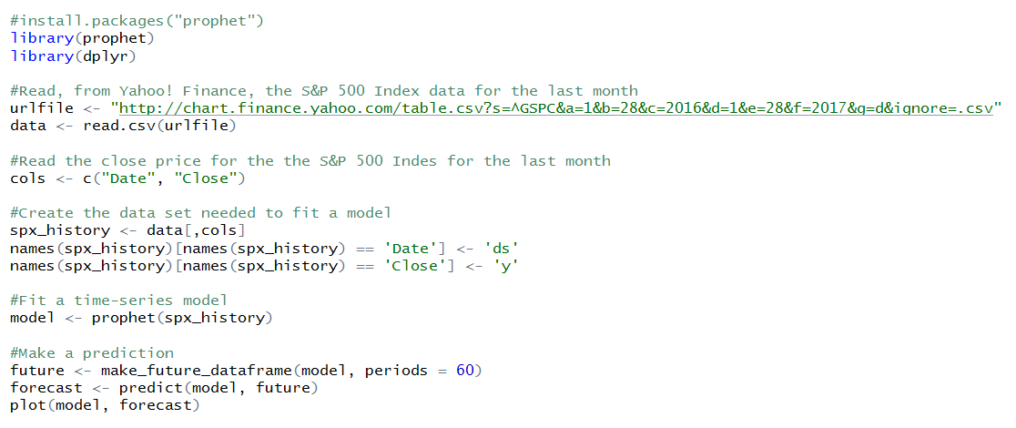
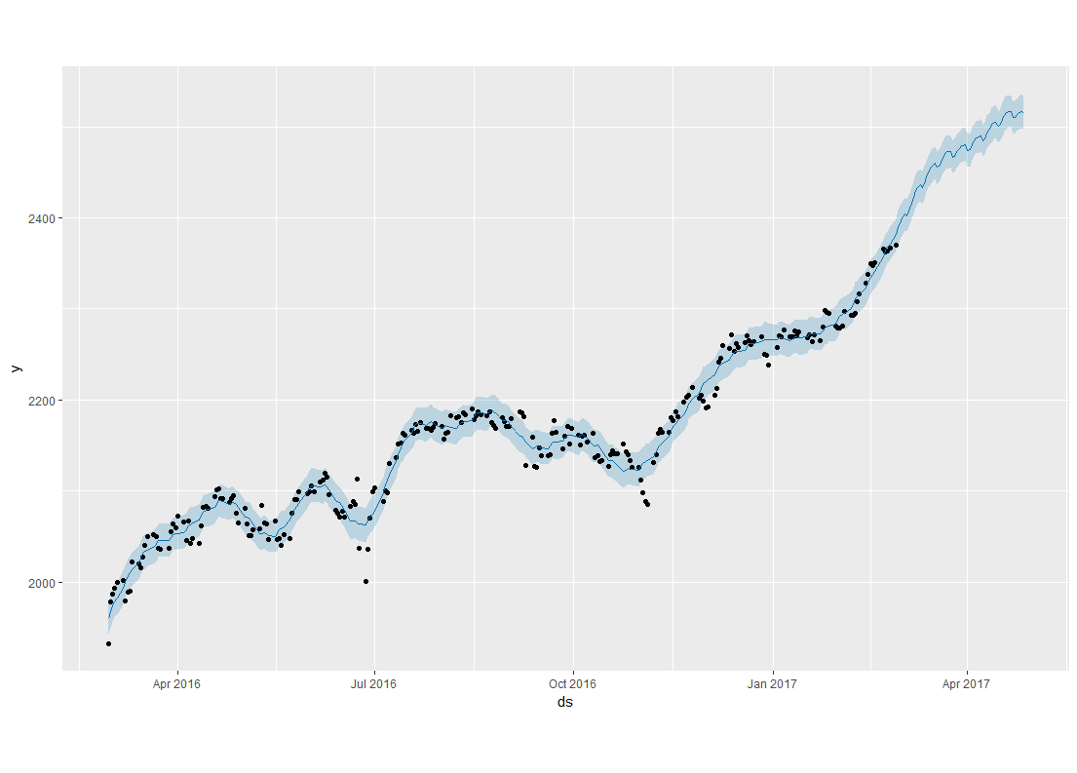
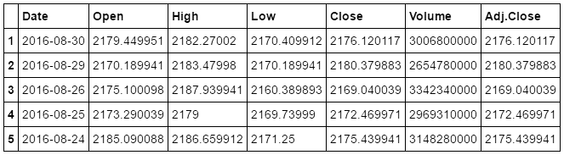
The machine-learning algorithm
Notes:
We start with an example of a machine learning algorithm. The code takes in data, builds a model, and uses the model to produce some result.

Slide 4
How the algorithm was created?
Coding progressed from top to bottom
It was created by an expert in the technique
The results informed stakeholders of their reality
The developer started with a blank screen
This is the right technique for the data
Notes:
We start with an example of a machine learning algorithm. The code takes in data, builds a model, and uses the model to produce some result.

Slide 5
How the algorithm was ^ created
really
It was created by an expert in the technique
Coding progressed from top to bottom
It was created by an expert in the technique
I know the language and understand the principles
Coding progressed from top to bottom
I started with the risky stuff first
It is evidence for or against a hypothesis
The results informed stakeholders of their reality
The results informed stakeholders of their reality
The developer started with a blank screen
The developer started with a blank screen
I copied and pasted a majority of the code
This is the right technique for the data
This is the right technique for the data
There are many other possible approaches
Notes:
More realistically, many who write algorithms understand the underlying principles involved, but often aren’t experts in the technique. The data scientist starts by writing the parts of the algorithm that are least understood. Much of the code is copied from other projects. There often is no single best way to analyze the data. Stakeholders often have existing beliefs about how the world works, independent of the algorithm’s results.

Slide 6
The art of the hack Build in small steps you understand
Decide on an algorithm
e.g., A time series forecast can predict website traffic
Do A Web Search
Search: Time series prediction using R
Copy and run the code
A working algorithm
Make a small change and run
Make a small change and run
Notes:
To operate on the level of a professional data scientist, you have to master the art of the hack. You need to get good at producing new, minimum-viable, data products based on adaptations of assets you already have.

Slide 7

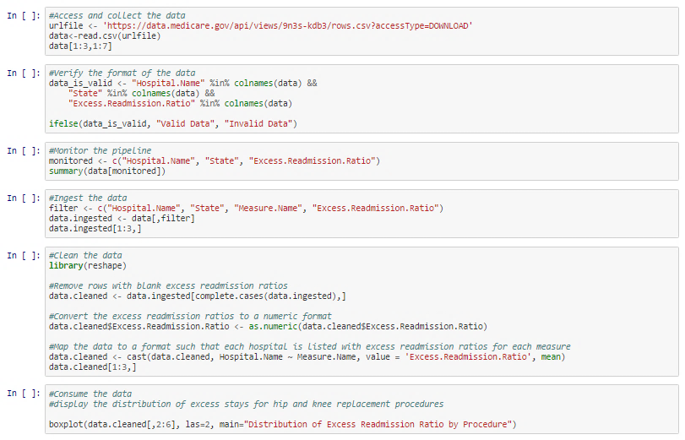
Let’s build an AI algorithm
Github.com/jerryaoverton
Notes:
We can learn about data pipelines using an example. This example uses an R script to model the essential elements of a professional-grade data pipeline.

Slide 8
What we covered
The life of a pro
How algorithms are really created
The art of the hack
DXC Proprietary and Confidential
January 17, 2019
8

Slide 9
Thank you.
http://dxc.technology/analytics

